Slide 1
Background: Circular economy and bioeconomy
September 2021

Slide 2
Contents (rough indication here of the sort of pages that would be useful – some of these topics may need several pages to cover, no problem at all if this slidepack gets quite long)
What is a circular economy / bioeconomy
Role in reducing emissions – why, how and how much
Other benefits – innovation, adaptation etc
Barriers / policy issues (findings from last years research – see slides 6,9-12)
Business models (take from ERP chapter and build)
How circular now – and how to measure?
Skills and jobs in a circular/ bioeconomy ? (not sure we have much on this – may require some new thinking / desk research)
Examples (Maral) building, food/ag, fashion?
Annex –

Slide 3

What is the issue?
Resource extraction and production in the current linear extractive model is exceeding our planetary boundaries
If everyone in the world consumed like the average New Zealander, we would need nearly three Earths
If things don’t change, resource demand is forecast to keep increasing, due to population and economic growth
We need to rethink how we produce and consume

Slide 4
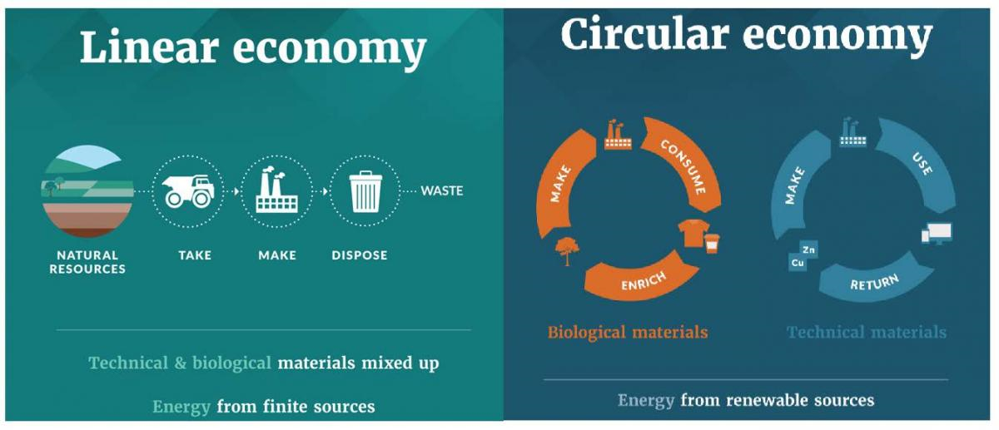
What is a circular economy?
There is no universally accepted definition, but it can be broadly understood as redesigning material flows in an economy
A circular economy is one that is restorative and regenerative by design – it is about optimisation of value circulation, not prevention of waste generation
A shift from a linear ‘take-make-waste’ to a circular ‘make-consume-recycle’ flow
It is not an ideal end-state, but a state of continuous and evolving development
Up to 80% of a product’s environmental impact is determined at the design phase
Notes:
Shifting to a performance economy, where stocks are managed for the long term

Slide 5
A circular economy for Aotearoa New Zealand
We need to redesign material flows in a way that is consistent with who we are/who we want to be
Mātauranga Māori starts from notion of human activity operating from a positon of abundance or rauora. Envisaging such a world demonstrates the gap, but also the opportunity, of seeking to regenerate natural systems as part of a circular economy.
In Aotearoa New Zealand we are informed by our unique history and values
Six principles for a circular economy:
Design out waste, pollution and emissions​
Keep products and materials in use, at their highest value​
Regenerate natural systems​
​Take responsibility for the past, present and future condition of our natural environment​
Think in systems, where everything is connected​
Deliver equitable and inclusive outcomes
Our agricultural sector is a very large part of our economy, accounting for nearly half our emissions (compared to 13% in Australia)
Notes:
Important we redesign material flows in a way that is consistent with who we are/want to be
The bioeconomy in NZ accounts for nearly half of our emissions profile

Slide 6
Circular principles in practice – designing out waste
Up to 80% of environmental impact occurs at the design stage
Modular product design for focused repair and replace
New technologies that meet exact requirements, e.g. 3D printing
Use of byproducts as inputs for other products
Platforms for sharing products and/or products as a service – changing the incentives that drive design choices

Slide 7
Circular principles in practice – keeping materials and resource in use
Service-life extension activities roughly substitute human inputs for energy and materials, compared to manufacturing equivalent new goods
Extend item life span, e.g. optimized maintenance through the IoT, predictive analytics, optimized spare parts
Resource recovery and transformation, e.g. ocean plastics
New technologies, e.g. value chain trackers
Secondary materials strategy, e.g. remanufacturing, take-back programmes, industrial symbiosis

Slide 8
Circular principles in practice – regenerating natural systems
This is fundamentally about good inventory management – moving from an industrial economy measured in flows, to a performance economy measured by the quantity and quality of capital/stocks
Bio-materials that add value upon composing
Renewable energy sources at scale (reconsider role of hydro)
Natural production for new materials, e.g. seaweed farming for bioplastics
Reduce strain on natural lands, e.g. new sources of protein
Circular agriculture

Slide 9
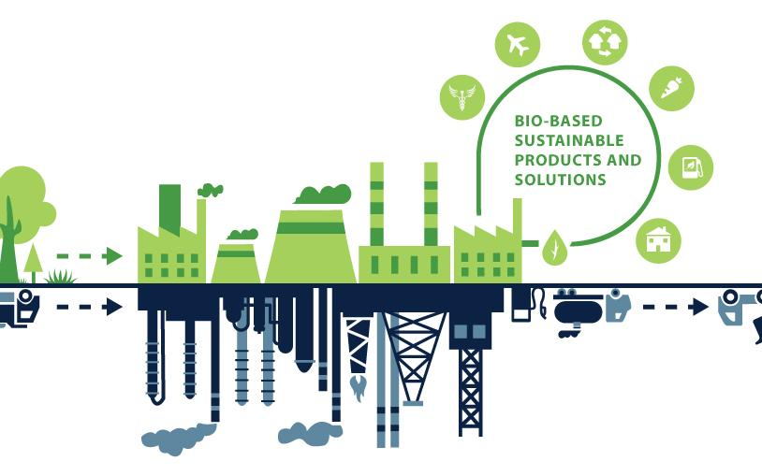
What do we mean by the bioeconomy?
It’s a way of understanding where our industrial inputs come from
The bioeconomy encompasses the use and regeneration of biological resources (including knowledge and technology) to provide information, processes, products and services
The bioeconomy is a renewable path to displacing non-renewable resources drawn from the lithosphere (drilling, mining)
Food systems occupy the biggest niche, followed by bio-products ranging from wood products to medicinal agents, then bio-energy

Slide 10
Bioeconomy concept has various lenses (from MPI)
Vision | Resources | Aims and objectives | Focus and products
Bio-technology | Highly-developed technology and knowledge | Economic growth and job creation | Research and commercialisation of bio-technology Bio-pharmaceuticals
Bio-resource | Bio-based materials e.g. woody biomass | Economic growth and sustainability | High-value bio-based products (primary industries), bio-refineries, waste management, optimisation of land use
Bio-ecology | Bio-based materials | Sustainability, biodiversity, conservation | Region-focused, circular economy, bio-based products
Strategy likely to encompass all of these dimensions.
Notes:
Biotechnology vision emphasises the importance of bio-technology research and application and commercialisation of bio-technology in different sectors;
Bioresource vision focuses on the role of research, development, and demonstration (RD &D) related to biological raw materials in sectors such as agriculture, marine, forestry, and bioenergy, as well as on the establishment of new value chains. Whereas the bio-technology vision emphasises a point of departure in the potential applicability of science, the bioresource vision emphasises the potentials in upgrading and conversion of the biological raw materials;
Bioecology vision that highlights the importance of ecological processes that optimise the use of energy and nutrients, promote biodiversity and avoid monocultures and soil degradation. While the previous two visions are technology-focused and give central role to RD &D in globalised systems, this vision emphasises the potential for regionally concentrated circular and integrated processes and systems.

Slide 11
Why are we thinking about the circular economy and the bioeconomy together?
Agricultural emissions account for nearly half of our emissions profile
Our transition to a circular economy will be considerably more focused on the bioeconomy than comparable countries like Australia or the EU28
We can leverage existing competitive advantages (current levels of science, like genetic databases, grass breeding, herd tagging)
Notes:
Agriculture accounts for 13% of Australia’s emissions profile

Slide 12
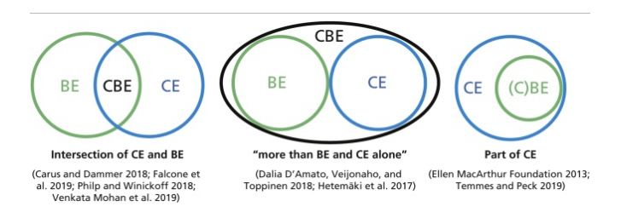
Circular economy and bioeconomy and their intersection are emerging concepts
ERP discussion doc and briefing suggest this model for a strategy:
circular economy with bioeconomy component (encompassing all biomass resources)
We are keeping in mind other approaches as we engage with stakeholders and experts

Slide 13
Intersection with climate change
This work is being driven by the Emissions Reduction Plan
The Paris Agreement aims for a limit of 2 degrees warming, which will still incur billions in climate costs
Currently, if everyone meets their agreed targets, we will still miss this (achieve between 2.4 and 3.7 degrees)
NZ has announced a target of a 1.5 degree limit
The circular economy can help bridge this aspirations-pledge gap
Doubling circularity globally has the potential to plug the gap
Increasing even more can help wind warming to under 2 degrees and save billions
Notes:
“New Zealand has made the 1.5 degree limit the heart of our domestic climate change legislation. We have committed to a 2050 target and we are revising our Nationally Determined Contribution” – Jacinda Adern UNGA 2021

Slide 14
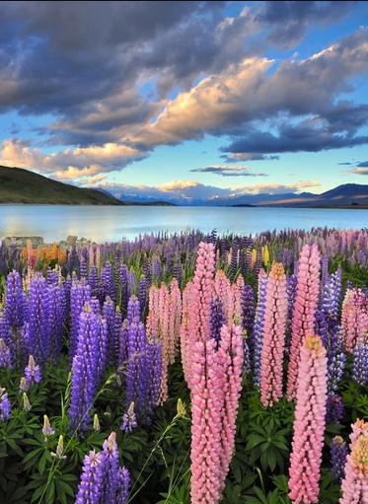
Other benefits from a more circular economy
Regenerating ecosystems
Can help mitigate climate risks, e.g. restored wetlands reducing flood impacts
Acknowledges the environment has intrinsic value independent of human needs
Resilient supply chains
Protect against volatile international prices
Reduce dependence on trade for strategic resources/market access
Reduced dependence on politicised materials
Recycling can reduce the need for coltan, cobalt, rare earth minerals
A more circular bioeconomy can produce and displace some imported inputs

Slide 15
Circular principles in practice – business models
How to organise a business to reduce waste? (design of products, design of delivery, strategy for managing waste)
Packaging
Construction waste
Ownership vs access models
How can government support?
Strong signalling – e.g. EU directive on eco-design, procurement strategies
Support – e.g. funding…research…
Market intervention – e.g. Dutch tax on virgin plastics

Slide 16
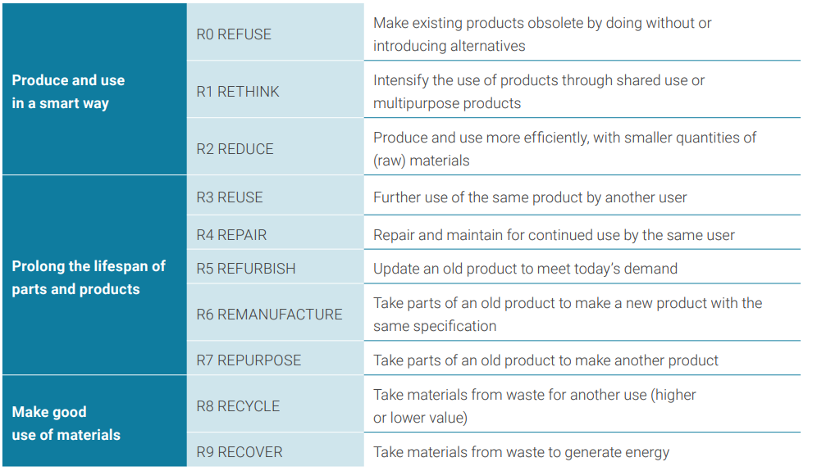
Circular principles in practice – R-strategies
The “R-Ladder” showing the hierarchy of the nine R-strategies in order of priority
(Netherlands Environmental Assessment Agency, 2019, European Environment Agency, 2019)

Slide 17
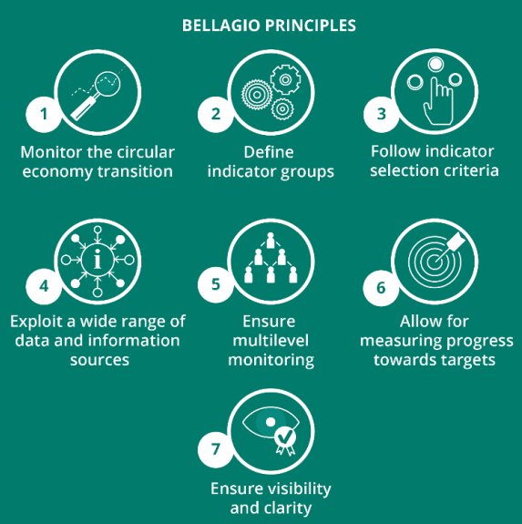
How circular are we now – how to measure?
The circularity of individual economies is difficult to quantify. Accurate indicators of circular performance are still being developed.
The EU launched their first circular economy plan in 2015, and have reviewed and done a gap analysis on the metrics in use.
The Bellagio Declaration was published in March 2021 and consists of seven principles capturing the essential elements of a circular economy monitoring framework.
Notes:
1) Monitor the Circular Economy Transition
Monitoring the transition towards a circular economy needs to holistically consider all relevant initiatives – public and private - across the economy. It should capture the full extent of changes happening to the material and waste flows, products over their life cycles, business models, and consumer behaviour, including the economic, environmental and social dimensions of these changes.
2) Define indicator groups
A robust monitoring system for the Circular Economy transition should include:
Material and waste flow indicators to monitor changes throughout the material life cycle including resource efficiency dimensions.
Environmental footprint indicators to capture the impacts across the full life cycle of products and materials, so that spill-over effects are assessed, and planetary boundaries are respected.
Economic and social impact indicators to capture positive as well as negative impacts that may occur during the structural changes of the circular economy transition.
Policy, process, and behaviour indicators to capture the implementation of specific Circular Economy policy measures and initiatives, in particular for key sectors.
3) Follow indicator selection criteria (RACER)
Indicators included in a transparent monitoring framework for the Circular Economy transition should follow RACER criteria: Relevant, Accepted, Credible, Easy to monitor, and Robust. However, development of innovative, experimental indicators should also be encouraged, even if not all RACER criteria may initially be fulfilled.
4) Exploit a wide range of data and information sources
The data underpinning a monitoring framework for the Circular Economy Transition may consist of:
Official statistics from the European Statistical System or National Statistical Offices, other data produced by EU institutions, national or local authorities, as well as from international organisations) – Exploiting and integrating official information sources.
Policy information – Tracking policy developments and implementation including qualitative assessments.
New data sources – Exploiting new information sources beyond official statistics, such as data from the private sector and trade associations, research models, or from new applications of digital technologies.
5) Ensure multilevel monitoring
Monitoring should capture changes happening across all levels of the economy. It should address both public and private sector stakeholders, and different governance levels from global to local scale. A well-defined monitoring and governance structure is required to promote the development of coherent metrics that capture the multiple dimensions of the circular economy transition.
6) Allow for measuring progress towards targets
Monitoring Circular Economy implementation should help assess progress to relevant policy targets and objectives, thus helping inform if the right policies are in place and well implemented, or if corrections or new policies are needed.
7) Ensure visibility and clarity
A well-designed Circular Economy monitoring framework will inform policy makers, stakeholders and citizens. Appropriate indicators as well as user friendly methods of communication, such as dashboards, should therefore be identified. Where possible, open data principles should be followed, with data being made fully and freely available.

Slide 18
How circular are we – indicators we need
The Bellagio Declaration identified four groups of indicators that every robust circular economy monitoring system should aim to have (EPA Network, 2021)
Material and waste flow indicators capture macro-level changes in the material lifecycle.
Environmental footprint indicators capture impacts across the full value chain of products and the full lifecycle of materials, such that spill-over effects are assessed and planetary boundaries respected.
Economic and social impact indicators capture positive as well as negative implications that may arise during structural changes of the circular economy transition, to ensure a just transition.
Policy and process indicators capture the implementation of specific circular economy policy measures and initiatives, in particular for some key sectors.

Slide 19
Types of indicators
Different uses and thus categories of indicators also call for different types of indicators.
In general, indicators may comprise for example input, output, production, throughput, process, or consumption (demand) indicators, often expressed as absolute numbers, percentages, or per unit or per capita, but the possibility of qualitative indicators should not be discarded.
An example is those that relate to citizen behaviour and views on the circular economy, or to compensate for areas where quantitative indicators are not yet available.

Slide 20
Types of indicators
There is a need for both production and consumption-based indicators, particularly related to impact, to capture the cross-boundary nature of resource use.
We can distinguish between circular indicators measuring at the macro, meso (sectoral), and micro level.
Governments, both national and municipal, typically adopt indicators at the macro level, whereas companies tend to apply micro level indicators.
Within companies, indicators are also applied at different levels, from product level to business unit, to the company as whole.

Slide 21
How to produce metrics
Working group including stakeholders
International
All parts of the supply chain from extractor to consumer

Slide 22
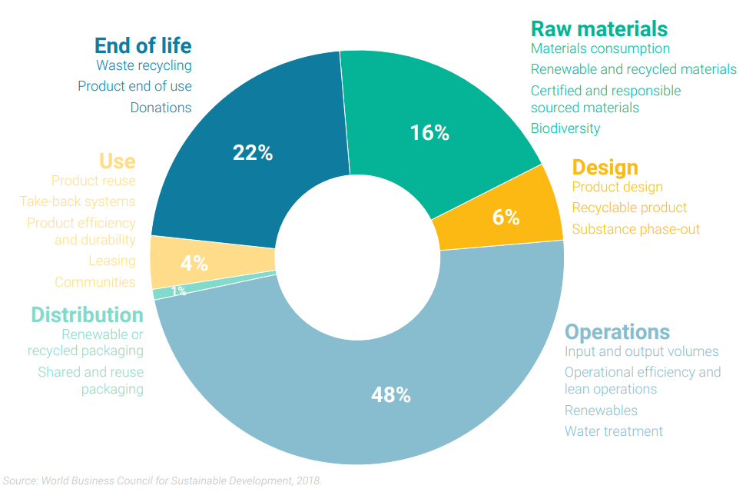
Where firms put metrics in place indicates focus
Sample of the use of circular economy or related resource indicators by companies across the resource lifecycle
Focus on operations aligns with focus on firms

Slide 23
Organisation of International Standards: metrics for a circular economy
NZ is an observer member of the ISO technical committee (ISO/TC 323) developing six standards for the circular economy, including “Circular economy — Measuring circularity framework”
Good metrics need to be:
Science-based
Based on credible and accessible data
Intuitive, and meaningful for the public
Work at different scales (individual-organisation-community-national-supranational)
Different ingredients for measuring circularity could include:
Material consumption (domestic consumption per capita, resource productivity)
Waste generation (total waste per capita, total waste in % of GDP)
Circular material use (circular material use rate)

Slide 24
Measuring the bioeconomy – UN System of Environmental Economic Accounting
The SEEA Ecosystem Accounting (SEEA EA) constitutes an integrated and comprehensive statistical framework for organizing data about habitats and landscapes, measuring the ecosystem services, tracking changes in ecosystem assets, and linking this information to economic and other human activity.
The United Nations Statistical Commission adopted the SEEA Ecosystem Accounting at its 52nd session in March 2021. The report of the Commission (subject to editing) can be found here.
This adoption follows a comprehensive and inclusive process of detailed testing, consultation and revision. Today, ecosystem accounts have already been used to inform policy development in more than 34 countries.
Ecosystem Accounting is built on five core accounts. These accounts are compiled using spatially explicit data and information about the functions of ecosystem assets and the ecosystem services they produce
Notes:
https://seea.un.org/ecosystem-accounting

Slide 25
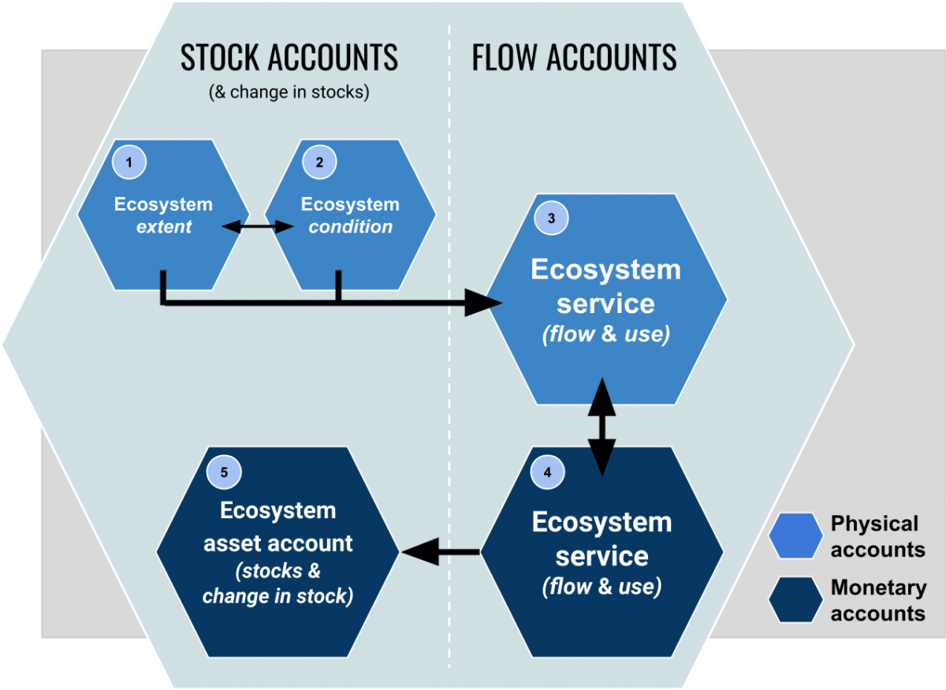
Measuring the bioeconomy – UN System of Environmental Economic Accounting
The five ecosystem accounts are:
1. ECOSYSTEM EXTENT accounts record the total area of each ecosystem, classified by type within a specified area (ecosystem accounting area). Ecosystem extent accounts are measured over time in ecosystem accounting areas (e.g., nation, province, river basin, protected area, etc.) by ecosystem type, thus illustrating the changes in extent from one ecosystem type to another over the accounting period.
2. ECOSYSTEM CONDITION accounts record the condition of ecosystem assets in terms of selected characteristics at specific points in time. Over time, they record the changes to their condition and provide valuable information on the health of ecosystems.
3. & 4. ECOSYSTEM SERVICES flow accounts (physical and monetary) record the supply of ecosystem services by ecosystem assets and the use of those services by economic units, including households.
5. MONETARY ECOSYSTEM ASSET accounts record information on stocks and changes in stocks (additions and reductions) of ecosystem assets. This includes accounting for ecosystem degradation and enhancement.

Slide 26
Skills and jobs
Impact on future of work
Four sectors (construction, food products, minerals, and power) account for 90% of global material use, and employ 15% of the global workforce
Role of education – particularly early education (Finland, Slovenia, start at kindergarten age, socialising circular behaviours), also retraining for changing job market (new waste management jobs, emerging bioeconomy jobs)
Considering the role of waste workforce (health and safety, workers often from marginalised groups)

Slide 27
Overseas examples in action
EU – EU-wide strategy, use of different levers (legislation, directives, rules)
Slovenia – zero waste
Netherlands – world leader, waste focused
Prague
Australia – VIC, NSW (responding to China 2018 waste ban)
Finland (large bioeconomy, particularly wood)
Canada (also have large bioeconomy)
Costa Rica

Slide 28

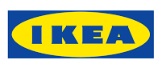


Circular business examples
Dell – taking e-waste gold from Salvation Army stores and partnering with a jewellery company to make jewellery entirely from e-waste.
Ikea – establishing a furniture take-back scheme in the UK, launching a national mattress recycling programme in the US, partnering with suppliers to source 100% recycled plastic for its products, building sustainable stores etc.
Philips Lighting ‘Pay per lux’ model - Philips installs bespoke, intelligent lighting systems that fit the needs of a space and at a manageable price for the customer. Philips maintains ownership of the materials, and the client benefits from maintenance and service, the option to adapt or upgrade the setup, with the manufacturer able to recover the materials when necessary.
H&M – vision to become 100% circular by 2030. Currently around 35% of the materials used by the company are recycled or sustainably-sourced.
Toast Ale – collects surplus bread from delis, bakeries etc and incorporates it into the brewing process with barley, hops, yeast and water. No special technology is required, but the simple switch can replace around a third of the malted barley used for beer.
Adidas – in 2018 produced 5 million pairs of shoes made out of ocean plastic – ramping this up to 11 million pairs in 2019 due to demand from consumers for more sustainable products.

Slide 29

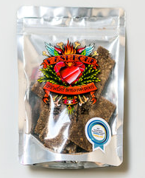
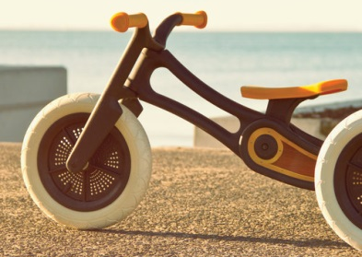
Circular business examples (cont’d)
And in NZ…
Ethique – produces solid beauty bars using sustainable and biodegradable ingredients and with compostable packaging.
Clearsite Demolition Ltd – deconstructs rather than demolishes houses. Salvages timber, features, fixtures and fittings that can be reused, repurposed or recycled.
Ecostock Supplies Ltd – takes more than 10 large truckloads a day of pre-consumer food waste and turns it into high-grade food products for animal feed.
Mashbone Dog Treats – developed dog biscuits made from a waste product of the brewing process.
Wishbone Design Studio has created a balance bike for children made from 100% post-consumer recycled carpet.
Innocent Packaging – Produces disposable food packaging made from plants.

Slide 30




Circular business examples
Allbirds – is a New Zealand-American company replaced the traditional Petroleum-based synthetics found in footwear by natural material, Merino wool. They also produced footwear made from eucalyptus tree fibre. In Feb 2021, they produced a plant-based leather that has 40 times less carbon impact than the traditional one.
Tuhoe iwi – is developing New Zealand first sustainable road using the Tall Oil Pitch resin that suppresses dust and has waterproofing qualities that reduces the occurrence of potholes and corrugations.
Emma Lewisham – beauty products supporting end of life return and refill.
Citizen – is a New Zealand food upcyling collective, which uses surplus foods and upcycle them into delicious food and drink. For example, upcycling waste bread into beer and then use brew waste into bread again.
Solo Plastic – produces pipes using high-density polyethylene (HDPE), which is one of the easiest plastic to recycle. They extract clean HDPE waste from any source (milk bottles), chipping it and extruding it into pellets for re-use into new products suitable for non-virgin material. They recycle 100% of all HDPE waste produced internally at Solo.
IFF – has partnered with a Dutch start-up, Peel Pioneers, to utilize fresh orange peels. They are washed and treated to obtain a high-quality, oil-in-water emulsion via cold extraction. IFF uses the essential oil to create signature taste designs, including natural orange flavourings and extracts.

Slide 31
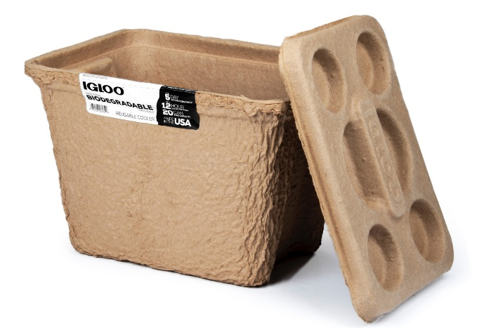
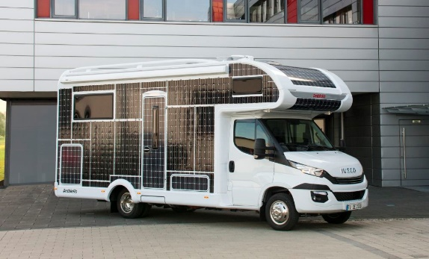
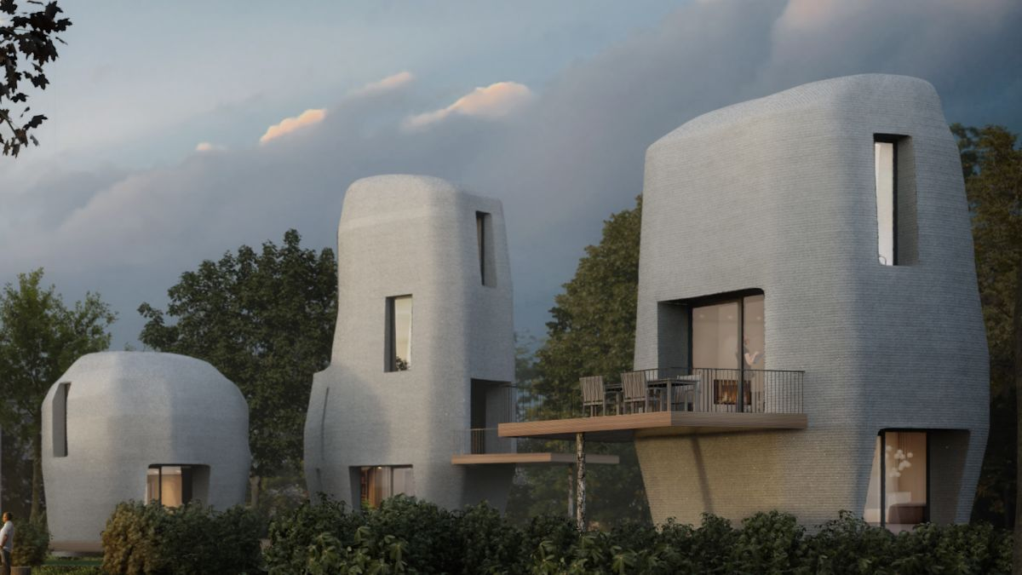
Circular business examples
Igloo – has created a biodegradable cooler made from paraffin wax and recycled paper called RECOOL. This is an amazing replacement for Styrofoam that contributes to greenhouse gases, doesn’t degrade for hundreds of years, and can potentially kill turtles, fish, and other creatures, who mistake it for food.
Desserto – launched the first vegan leather made from nopal (prickly pear) cactus. This partially degradable vegan is free of the toxic chemicals and phthalates that pollute our oceans after entering waterways. Also, it reduces the water consumption by 20% and plastic waste by 30-40%.
Dethleffs – manufactures solar-powered RVs that harness the power of the sun for energy, which means no fuel or charging station is necessary to get you where you need to go.
MacRebur – is producing a renewable asphalt—a mix of industrial and consumer plastic waste—replaces the oil-based sealing material that holds asphalt together in roads. This new asphalt is roughly 60% stronger and will last ten times longer than traditional asphalt roads and most importantly it is eco-friendly.
Researchers at Michigan State University – developed a transparent solar concentrator, which has the potential to turn any window or pane of glass into a solar cell.
MIRRECO – is developing a CAST hemp-based construction 3D printing process that will also be able to store CO2 removed from the atmosphere.
Battery Industry Group – offer an EV battery recycling service in New Zealand.

Slide 32

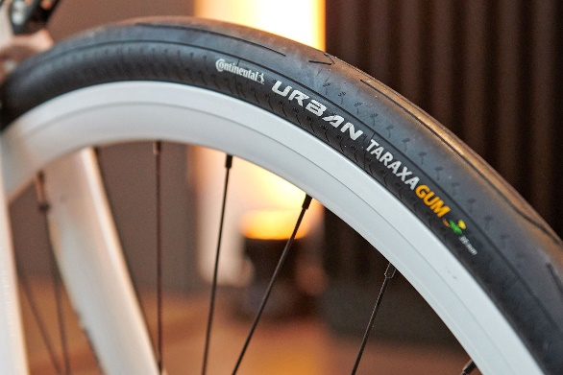
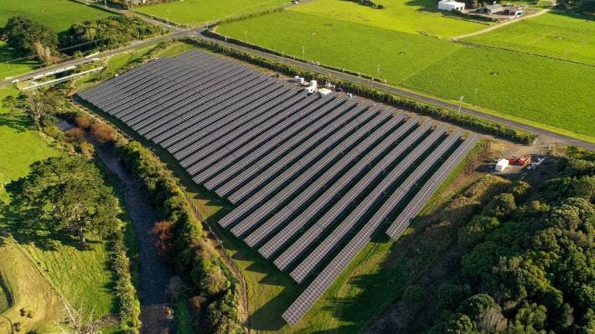
Circular business examples
The Kapuni Solar Power Plant, New Zealand's largest grid-connected solar power plant, features 5800 ground-mounted photovoltaic panels (2.1 megawatt) and can generate enough electricity to power more than 520 homes.
Continental has won the German Sustainability Award 2021 in the category “Responsible Design” for the Urban Taraxagum bicycle tire. While conventional tires for motor vehicles consist of about 30% caoutchouc from rubber trees, Continental tires made from dandelion rubber, which provide benefits in terms of land use and transportation.
Goodyear replaces petroleum based oils with soybean oils in their tire production. Besides replacing a fossil raw material with a bio-based material, the use of soybean oil also promotes resource efficiency.
Stora Enso is developing a technology that uses dry lignin from wood to manufacture a graphite replacement material for the needs of consumer electronics and the automotive industry, among others.
Navigator recycles carbonate sludges, a waste product of their pulp processing and production stage. The sludges are partially fed into the lime kiln, to produce white liquor, which, in turn, is used in the production of pulp.
Tuhoe iwi is developing New Zealand first sustainable road using the Tall Oil Pitch resin that suppresses dust and has waterproofing qualities that reduces the occurrence of potholes and corrugations.

Slide 33
Building and constructions
Conventional (past) | Circular & Bio (present) | Future
The building and construction industry is a major consumer of non-renewable resources such as stone, sand, and minerals. Buildings are emitting 39% of energy-related carbon emissions globally, with a breakdown of 28% from operational emissions (including heating, cooling, and powering the buildings) and the remaining 11% from materials and construction of buildings. | Bio-based construction materials replacing conventional building materials such as: wood and its products, such as LVL or CLT for loadbearing walls. natural fibres and resins for insulation, lining, and floor coverings. Good insulation reduce building lifetime energy use. Example: Neste Renewable Polymers and Chemicals, Arcadis. | 3D printing hemp house developing by MIRRECO. 3D printing design minimises the error in construction, which results into elimination of the extra use of material and waste. The entire house is based on a bio-based material, hemp, which is not only easily re-usable and recyclable but also a good insulation which reduces the energy use and also is able to store CO2 removed from the atmosphere.

Slide 34
Fashion
Conventional (past) | Circular & Bio (present) | Future
Textiles market: 41% natural and 59% synthetic. 61% of the natural fibre comes from cotton, which has a high water and chemical consumption in the production process. Petroleum-based synthetics in footwear production. Leather production from animal skins. | 1. Biodegradable fabrics like MMCF made from cellulose found in eucalyptus or beech wood, or natural bio-based fibres such as jute, flax, and hemp. 2. Biodegradable plant-based leather from nopal (prickly pear) cactus 3. Biodegradable footwear with eucalyptus tree fibre or natural wool reduction in water use reduction of pesticide, toxic chemicals and fertilizer full biodegradability (four to six weeks) using recycled cellulosic waste in the production 40 times less carbon impact Examples: DSM, Birla Cellulose, Allbirds | Virtual fashion

Slide 35
Pharmaceutical
Conventional (past) | Circular & Bio (present) | Future
produced by chemical synthesis with low yield and high production of waste products that required environmental control and special effluent treatment. | Plant-based pharmaceutical such as an HIV vaccine from tobacco plants, or carrot cells to treat certain metabolic disorders. Production by fermentation using biotechnology. Production by biological processes (biopharma) instead of chemical process. (especially for treating diabetes, cancer, and heart disease) Reduction in CO2 emissions Reduction of hazardous substances Reduction in production costs Examples: Medicago, BASF | Regenerative medicine (e.g. gene-editing) Tissue engineering

Slide 36
Vehicles
Conventional (past) | Circular & Bio (present) | Future
fossil fuels that significantly contribute to global warming | The Vehicle to Home (“V2H”) essentially transforms electric energy from vehicles in to mobile batteries, capable of transporting energy wherever it’s needed – be it homes, businesses or appliances, opening up exciting opportunities for customer self-sustainability and network resilience Examples: The Kapuni Solar Power Plant | Electric cars and Hydrogen cars will displace internal combustion engine (ICE) vehicles. Private vehicle ownership will be replaced by on-demand autonomous electric vehicles by TaaS fleets, not individuals. Vector, New Zealand’s leading distributor of electricity and gas, is exploring the possibility of turning end-of-life Electric Vehicle (EV) batteries into affordable power storage for homes and businesses.

Slide 37
Food
Conventional (past) | Circular & Bio (present) | Future
Production of food and drinks using new raw material Using chemical fertilisers Energy production by burning food waste Animal-based protein | using food losses and waste as new input materials conversion of food losses and waste into ethanol, biodiesel, and biogas. Composting food losses and waste and use it as fertiliser to enrich the soil without any negative impact on air or water quality. Using plant-based protein, fungi, seaweed, and aquatic plants. Examples: IFF, Citizen, Navigator | 3D printed food Precision Fermentation Cellular Agriculture Air protein

Slide 38
Annex slides

Slide 39
ERP consultation document…
‘New Zealand must take a well-planned but agile approach to a circular economy transition, including the bioeconomy. It must take an integrated approach, linking the economy with the wellbeing of people and the planet, in line with the living standards framework. Where possible we will combine strategies, to yield benefits across the four wellbeings – social, economic, environmental and cultural.
Taking time to find the best way forward and work with our partners should not slow the growing momentum in New Zealand. We will progress action where possible, while we set the strategic direction and foundations to see us to 2050.
Proposal : ‘The development of a strategy, in partnership with Iwi, for moving to a circular economy with a thriving bioeconomy, which outlines the vision, guiding principles, roadmap and the Government’s role.’
Questions in document:
Recognising our strengths, challenges, and opportunities, what do you think New Zealand’s circular economy could look like in 2030, 2040, and 2050, and what do we need to do to get there?
How would you define the bioeconomy and what should be in scope of a bioeconomy agenda? What opportunities do you see in the bioeconomy for New Zealand?
What should a circular economy strategy for New Zealand include? Do you agree the bioeconomy should be included within a circular economy strategy?
What is your views of the potential proposals we have outlined? What work could we progress or start immediately on circular economy and/or bioeconomy before drawing up a comprehensive strategy?
What do you see as the main barriers to taking a circular approach, or expanding the bioeconomy in New Zealand?

