Slide 1
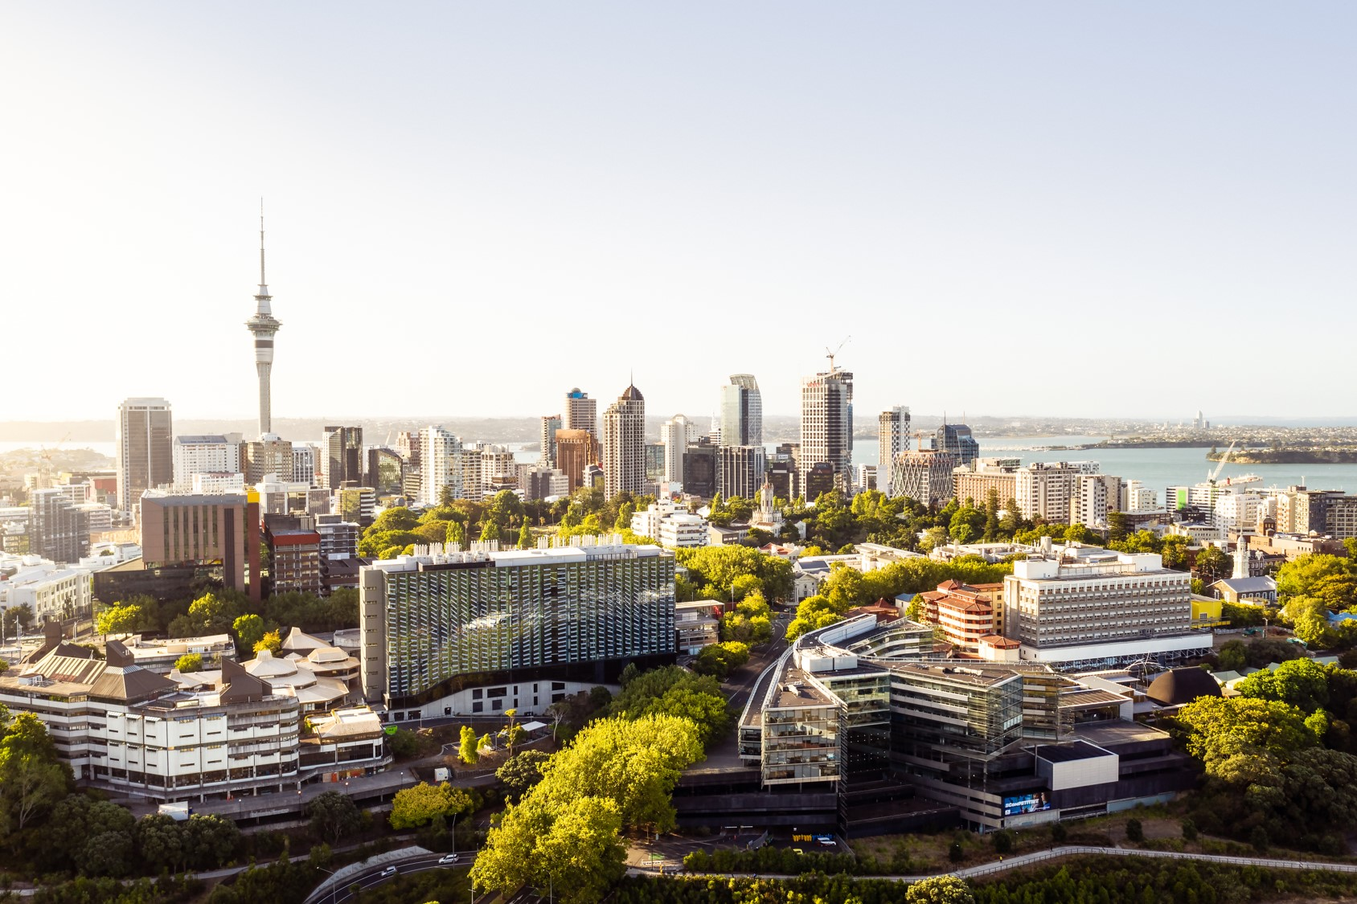

Faculty of Law B230
Valerie Linton / Adrienne Cleland / Simon Neale
26 June 2024

Slide 2
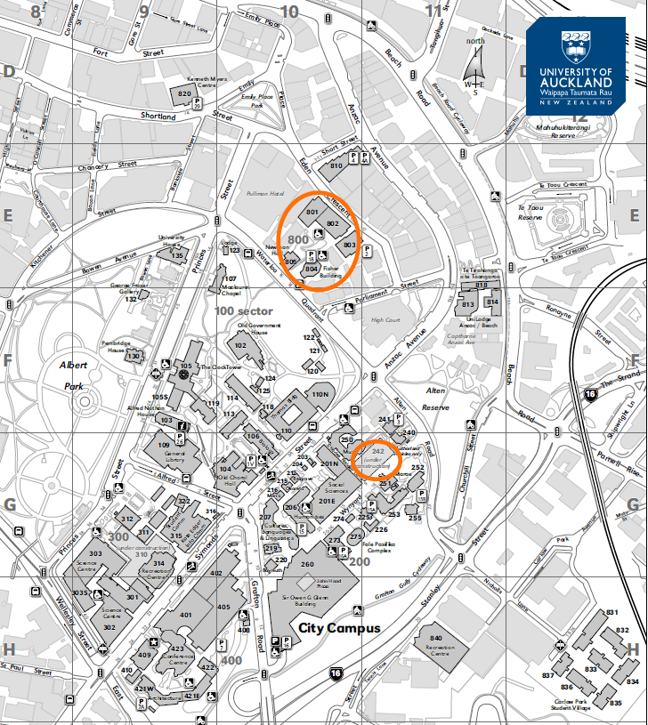
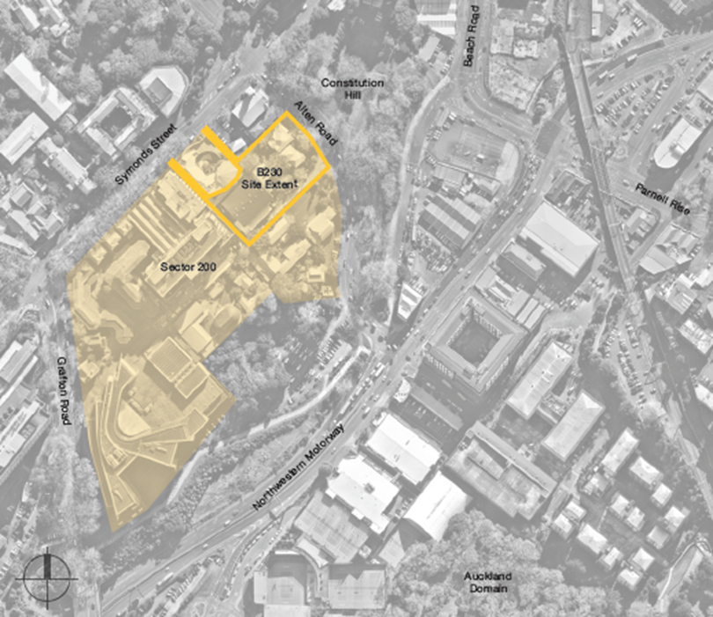
Faculty of Law – to move to central City Campus by end of 2029
Current poor quality accommodation
Leased buildings cannot be extended beyond 2029
University committed to development of new facilities for Law (and Performing Arts) in Sector 200
Property Services will work with Faculty members to gather “Statement of needs” for the new facilities
User group members have been identified and engagement will commence soon
Notes:
1 square edge = 200m
User group members have been identified and reviewed by the Dean, Acting Dean and Service Division Directors for their cohort.

Slide 3
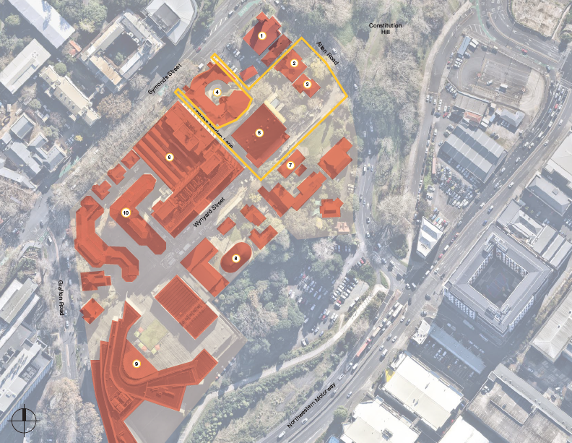
B230 Law and Performing Arts Project
Site Location

Slide 4
B230, Law and Performing Arts, high level milestones
Construction Milestones
December 2024
Phase one Wynyard Street landscaping complete (up to Charles Nalden Lane)
May 2025
Enabling works for B230. Site establishment, removal of Alten Road ECE building, removal of temporary courts
August 2025
Main construction for B230 begins
2028
Building work complete
Q2 2029
Wynyard Street landscaping complete
Project Milestones
2024 Preliminary Design Complete
User needs specified
Preliminary design established
Full business case submitted
EOI for Main Contractor
Q2 2025 Developed Design Complete
Full business case approval required
Resource consent obtained
Final user group sign off
Alten Road ECE operations relocated
Q3 2025 Detailed Design Complete Building Consent documentation
  2027 Faculty Relocation Planning
  2028 Faculty Transition Planning
    Fixtures, Fittings & Equipment Installation
  2029 B230 Operational
  Building occupation occurs
  Soft Landing (Project handover to FM team)
Notes:
This is a high level overview of the timeline for the Law and Performing Arts B230 design and build schedule.
The construction are on the left and the broader stakeholder-related (user groups and University management) milestones are on the right.
Note – the final business case will need to be submitted before the end of 2024.

Slide 5





Key Themes of Te Rautaki Tūāpapa
Key themes within Te Rautaki Tūāpapa, in alignment with Taumata Teitei
Environmental Performance
Distinctive Sense of Place
Flexible and Capable
Student-centred spaces
Affordability
Green buildings
Net-zero carbon
Renewable power sources
Removal of fossil fuel
Sustainability
Waste Prevention
Grey water
Reduce, Reuse and Recycle
Biodiversity
Te Aranga design principles
Our place in Aotearoa and the Pacific
Historical significance
Native planting
Biodiversity
Equity
Connectedness
Creating vibrant spaces and environments
Supporting curriculum review
Research support
Medtech-iQ and Innovation Space
Equitable access
Universal design
Adaptable layouts / movable furniture
Bookable spaces
Secure space available 24/7
Seamless digital and physical
Brilliant Basics
Student hubs
Tuākana spaces
Student controlled and managed spaces
Ability to learn, collaborate and socialise
Teaching building to support new pedagogy
Student co-design
Innovation
Exit leased spaces
Optimise utilisation and operation of space and dovetail curriculum
Review asset renewal plan
Prioritise investment
Capital generation
5

Slide 6
Estate Strategy Design Principles
Distinctive Sense of Place
Design with reference to Te Aranga Māori design principles
Showcase our distinctiveness and celebrate our place in the world
Respects our history and Māori heritage
Sustainable
Facilitates our University Sustainability Strategy
Facilitates and delivers our net-zero carbon target
Factor environmental sustainability, whole-life costing, and lifetime carbon in investment decisions
Meet the highest standards of efficiency for energy and utility use
Effective and Efficient
Deliver high quality and long-term solutions that will stand the test of time
Leverage our estate to support Taumata Teitei
Deliver flexible, capable, and rightsized spaces
Reflect new ways of working and the new curriculum, facilitating efficient and sustainable space utilisation within a space management policy and new space management standards
Plan holistically and join up sources of funding to deliver the most cost-effective solutions on a life-cycle basis
Scrutinise all estate investment decisions through business case review, implementing whole-life costing and carbon evaluation of projects
Exit poor quality space and consolidate into our owned estate
Notes:
Distinctive
Design with reference to Te Aranga Māori design principles
Showcase our distinctiveness and celebrate our place in the world
Respects our history and Māori heritage
Sustainable
Facilitates our University Sustainability Strategy
Facilitates and delivers our net-zero carbon target
Factor environmental sustainability, whole-life costing, and lifetime carbon in investment decisions
Meet the highest standards of efficiency for energy and utility use
Effective and Efficient
Deliver high quality and long-term solutions that will stand the test of time
Leverage our estate to support Taumata Teitei
Deliver flexible, capable, and rightsized spaces
Reflect new ways of working and the new curriculum, facilitating efficient and sustainable space utilisation within a space management policy and new space management standards
Plan holistically and join up sources of funding to deliver the most cost-effective solutions on a life-cycle basis
Scrutinise all estate investment decisions through business case review, implementing whole-life costing and carbon evaluation of projects
Exit poor quality space and consolidate into our owned estate

Slide 7
Estate Strategy Design Principles
Equitable
Ensure spaces are accessible and enabling for all
Adopt universal design principles
Supports the delivery of the Disability Action Plan
Support all our communities through collaborative design and engagement
Recognise and support the differences in our communities
Create effective and pleasant work environments that all staff enjoy
Student First
Adopt a student first approach to the provision of services and facilities
Ensure that the estate supports an excellent student experience
Provide excellent teaching and learning spaces that are inspiring places to study
Enables excellent student support and pastoral care
Responsible and Adaptable
Create long-life buildings that are flexible and adaptable in the long term
Deliver cost-effective solutions with long-term benefits
Minimise disruption through holistic planning
Maximise the use and value of land assets
Notes:
Equitable
Ensure spaces are accessible and enabling for all
Adopt universal design principles
Supports the delivery of the Disability Action Plan
Support all our communities through collaborative design and engagement
Recognise and support the differences in our communities
Create effective and pleasant work environments that all staff enjoy
Student First
Adopt a student first approach to the provision of services and facilities
Ensure that the estate supports an excellent student experience
Provide excellent teaching and learning spaces that are inspiring places to study
Enables excellent student support and pastoral care
Responsible and Adaptable
Create long-life buildings that are flexible and adaptable in the long term
Deliver cost-effective solutions with long-term benefits
Minimise disruption through holistic planning
Maximise the use and value of land assets

Slide 8
Estate Strategy Design Principles
Effective and Efficient
The Davis Law Library collection and services will be consolidated within Central Library Services and will therefore not be replicated in the new premises. We will explore possibility of retaining special collection in the Moot Court.
A new Moot Court will be provided in the new building
Equitable, Responsible and Adaptable, Student First, Affordable
The design of academic and professional staff office space will reflect new ways of working and recent patterns of office use and occupation.
Supports modern patterns of study for students and collaborative working
Notes:
The Davis Law Library collection and services will be consolidated within Central Library Services and will therefore not be replicated in the new premises.
The Libraries and Learning Services 2018 Service Delivery Model changes reduced the number of staffed physical service points from 11 to 5 (plus the On Demand Collection at Tāmaki). This was completed at the end of 2023 with the closure of the Epsom campus and amalgamation of the Sylvia Ashton Warner Library into the General Library.
In 2018 it was decided that the Davis Law Library remain as an LLS service point whilst in its location at Eden Crescent at the far edge of the City Campus. The proposed new Law and Performing Arts building addresses the access and proximity issues; consequently Law library services and collections can be consolidated within the General Library (in line with all other faculties on the City Campus and in line with the Library function plan).
The design of academic and professional staff office space will reflect new ways of working and recent patterns of office use and occupation.
The design phase for the Law and Performing Arts project will assess current and future usage needs and make recommendations in line with the evolving Future of Space deliverables. Multi-use, bookable space will be prioritised to increase utilisation potential.

Slide 9
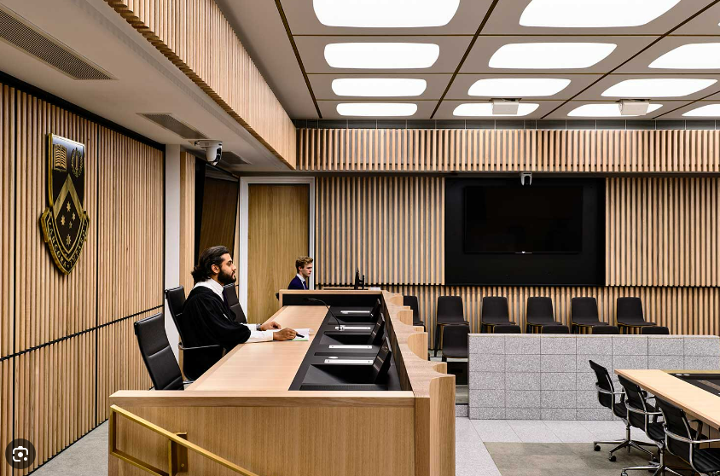
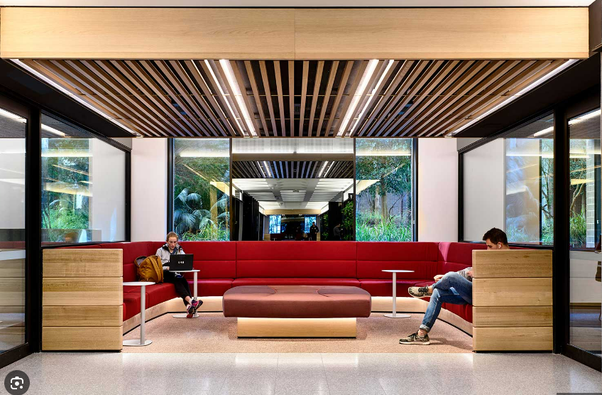
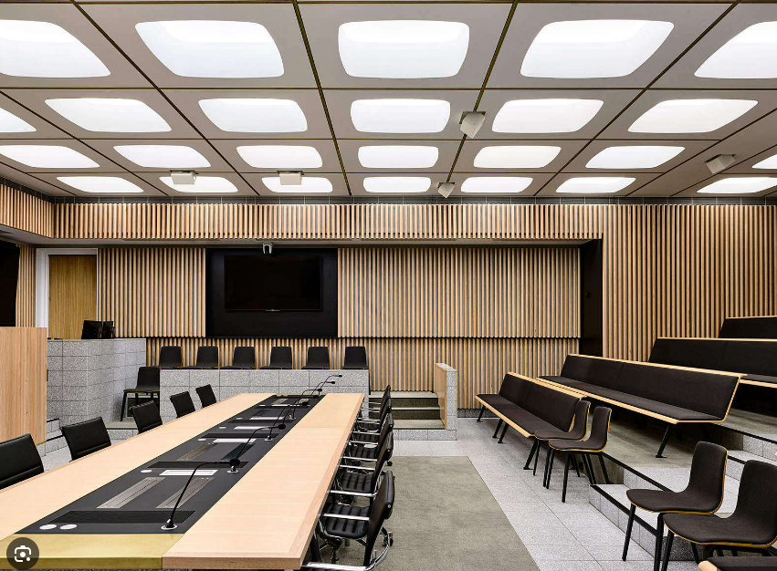
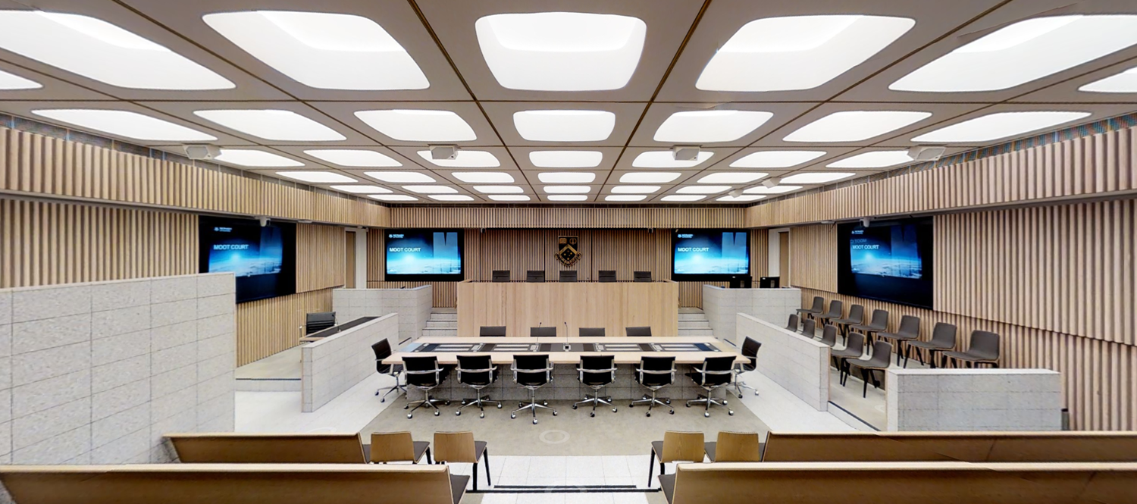
B230 – Moot Court (Monash as example)
Notes:
1 square edge = 200m
User group members have been identified and reviewed by the Dean, Acting Dean and Service Division Directors for their cohort.

Slide 10






B230 User group engagement timeline
ILM complete and UEC has approved design statements to guide user group approach. Planned engagement and timeline for user group sessions is below. Engagement will be with the Property Services team and Design Consultants.
Faculty Exec Meeting
Preliminary Design
round 2 complete
CEC Review
User group members have already been identified and a schedule of user group workshops defined.
Post Law Exec update, the invites will be sent to user group members and engagement will begin.
Second iteration of user group sessions.
28 May
26 June
26 July
23 August
18 October
4 November
UEC Endorsement
Preliminary Design round 1 complete
Business Case Ready for Assurance
UEC endorsed design statements that set the parameters regarding the future of the Davis Law Library and office space planning.
First iteration of user group sessions.
Definition of “Statement of Needs”.
Progress to Developed Design.
Full business case refined.
Notes:
UEC approved the design statements (relating to Davis Law Library and office planning) and endorsed engagement with Faculties and the user group members.
Dates have been updated to reflect current plan (very tight timelines).

Slide 11





B230 Primary User Group Overview
Performing Arts
Law
Law Moot Court
Events and Functions
Student Spaces
Membership
Faculty of Arts
CAI
EDSW
(New Faculty)
Campus Life
Faculty of Law
Faculty of Law
Libraries and Learning Services (LLS)
Campus Life
Event Services
LLS
Campus Life and Student Reps
Faculty of Law
Student and Academic Services
Impact
New Performing Arts theatre facilities (Replacement of Maidment)
All Faculty of Law operations to be relocated to sector 200 in the City Campus
A Moot Court will be integral to B230
Potential event and function space in B230
Student-first approach. Bookable spaces
Indicative scope
Performing Arts teaching space and venue requirements
Flexibility of space
Utilisation profile
Revenue generation considerations
Relocation of faculty operations.
Identification of specific requirements.
Opportunities to use space differently
Visibility of the Faculty at lower levels of the building.
Requirements for Moot Court facilities and aesthetics.
Opportunities for generating revenue (commercially bookable space for events, for filming)?
Theatre space aspirations.
Café requirements.
Communal open-plan areas.
Activating Wynyard St for events.
Revenue generation opportunities.
Identification of priorities.
Identification of types of spaces desired.
Equity.
Accessibility.
Distinctive sense of place.
Flexible and capable spaces.
Utilisation profiles.
Approach and desired outcome
Review former Maidment Theatre facilities and utilisation
Analyse BAU activities and facilities – how and where are activities being run now, SWOT analysis?
Aspirational function – what would the new facility unlock?
Statement of need for Performing Arts facility.
Davis Law Library relocated within LLS
Review faculty plan (size, shape and composition), future pedagogical delivery methods, academic office space requirements.
Overlay future of space design principles.
Statement of need for the faculty of Law.
Review of current space requirements and utilisation.
What international precedents should we consider?
Are there emerging requirements?
Statement of need for the Moot Court.
Determine the level of ambition and potential for revenue generation.
Determine the priority between faculty operations and complementary activities.
Statement of need for Campus Life events and functions.
What are student expectations on space functionality and availability?
What does Brilliant basics mean to the student cohort?
Communal space requirements.
Study, social and commercial space requirements.
Statement of need for Student Spaces.
Notes:
The primary user groups are listed above, along with the anticipated impact, indicative scope of user group design discussions and the high level proposed approach. User group members have already been identified and are awaiting invites to the sessions.
Additional user groups will be engaged to input into the design in relation to their specific requirements, including;
Equity and accessibility
Academic and Professional staff office accommodation
Teaching and Learning
Building operations (FM and theatre)
Cultural narrative strategy
Pool teaching and timetabling
Other Faculty opportunities within B230 tower

Slide 12






B230 Proposed stakeholder engagement (2024)
IMPACTED FACULTIES
CPBC / UEC / PSLT
Stakeholders that will move into the B230. Awareness
of programme objectives
and timeline overview.
PROPOSED STAKEHOLDER ENGAGEMENT
Overview of the preliminary design phase and programme timeline.
PDDC
CENTRAL COMMS
Acknowledgement that the Faculty of Law will need to move from its current location by 2029.
Proposed approach to stakeholder engagement during the preliminary design phase (end of 2024). The communication is aimed at raising awareness that the Faculty of Law is required to relocate and that the University plans to build B230 in Sector 200 to accommodate Law and Performing Arts in the future.
High level messages to staff and students that Law and Performing Arts are being invested in (pre construction).
USER GROUPS
STAKEHOLDERS
Invites issued for workshops. Concept Design review and statement of needs specified
Reassurance that Law and Performing Arts is coming to the City Campus. Early awareness and stakeholder analysis.
A.R.D
Engagement with alumni and potential donors.
Notes:
This proposed stakeholder engagement approach is for the concept and preliminary design phases (until the end of 2024). It is designed to raise awareness that the Faculty of Law will require new accommodation from 2029 and that the University plans to develop B230 in sector 200 to accommodate Law and Performing Arts, as part of which a number of user groups have been engaged to specify their future needs.
UEC have set the design parameters regarding the Davis Law Library and office planning.
Faculty Exec Teams will be briefed on the programme objectives, timeline and user group engagement approach (the Faculties that will operate in the new building).
PDDC and PSLT will be given an overview of the design timeline and major milestones.
User groups will be briefed on the initial concept design and asked to document their statement of needs.
Impacted Faculty comms to be prepared and sent by respective Dean (or Acting Dean) to make them aware of the future move/relocation
It is anticipated that there will be some “chatter” amongst staff when the user groups have been engaged and we propose that a high level message go out to staff and students to let them know about the investment in Law and Performing Arts and that a site in sector 200 is the likely new location. Other high level details will include the need for the relocation, an overview of the design process, and the estimated timeline.
We will take advice from the impacted faculty Deans on whether external stakeholders require high level information to either reassure them or enthuse them about the investment in to Law and Performing Arts in the city campus. Potential engagement with ARD to manage stakeholders and / or create investment opportunities.
The communication required as part of the deliverables in the previous slides are B230 project deliverables (e.g. Concept Design presentation, Business Case documentation, etc). Alten Road ECE are already engaged with Property Services and Campus Life about the relocation of operations and the associated timeline. This overview does not include Programme and Project Governance communications.
A comms and stakeholder engagement plan will be developed for future phases.

Slide 13
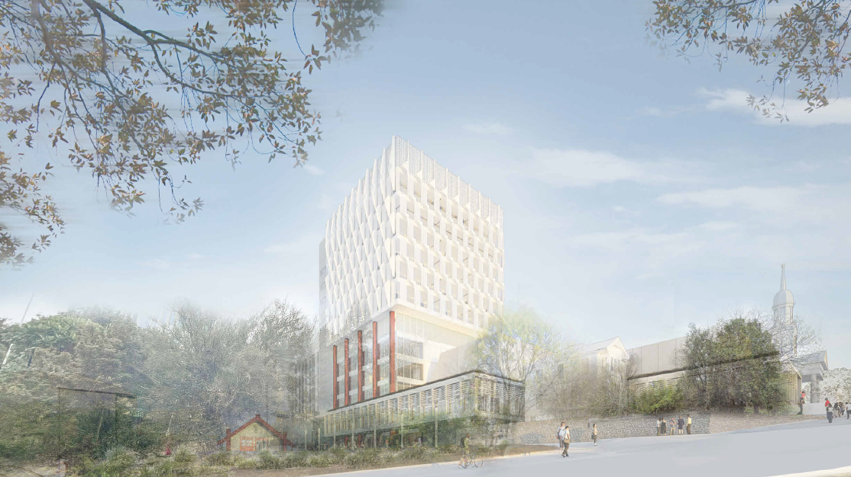
B230 Law and Performing Arts
Concept Design and Development
View from Constitution Hill

Slide 14
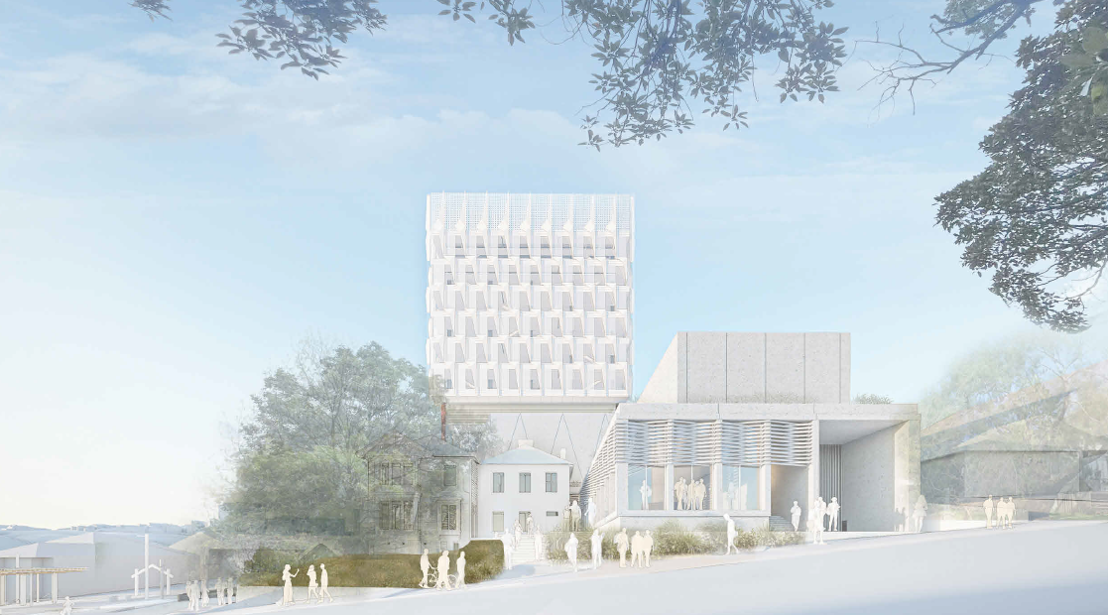
B230 Law and Performing Arts
Concept Design and Development
View from Alten Road

Slide 15
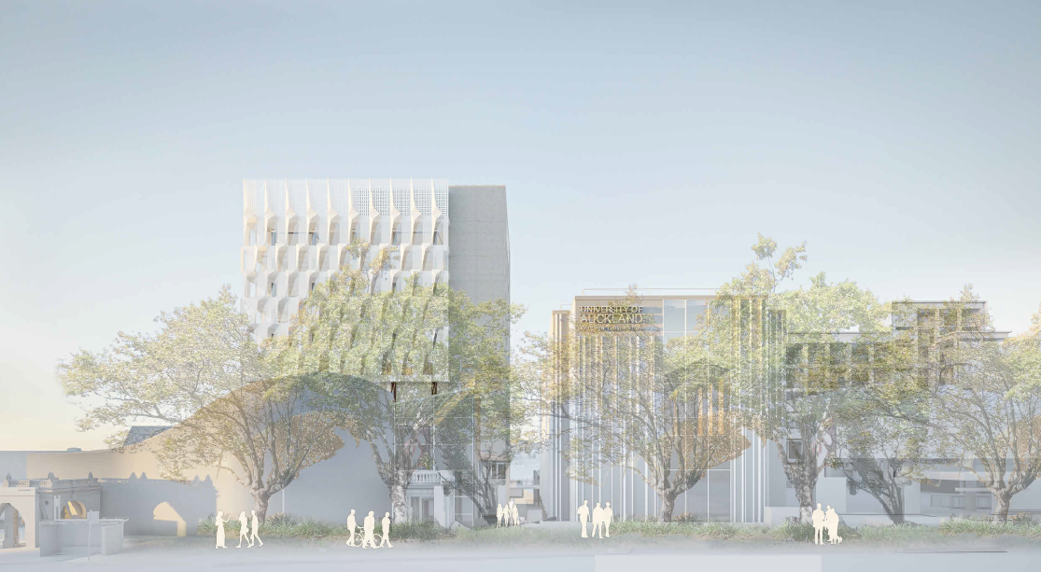
B230 Law and Performing Arts
Concept Design and Development
View from Symonds Street

Slide 16
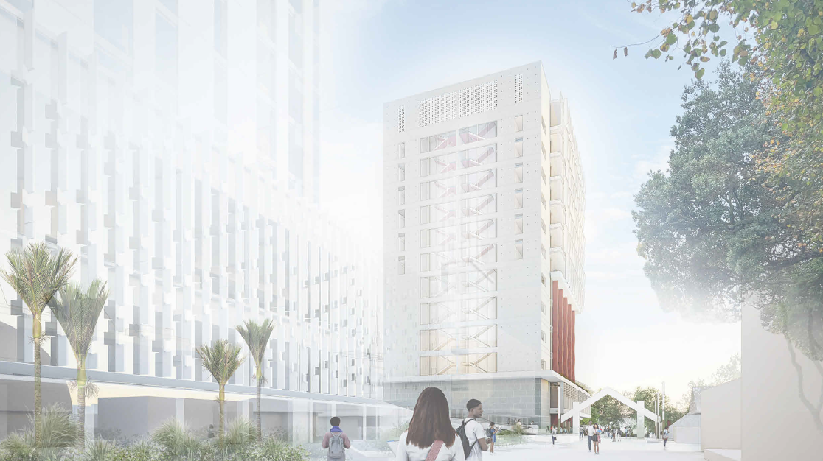
B230 Law and Performing Arts
Concept Design and Development
View from Wynyard Street

Slide 17
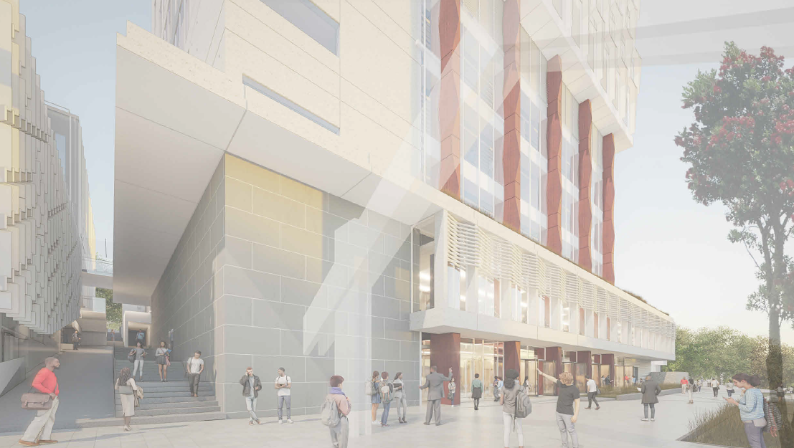
B230 Law and Performing Arts Concept Design and Development
View of Charles Nalden Lane

Slide 18
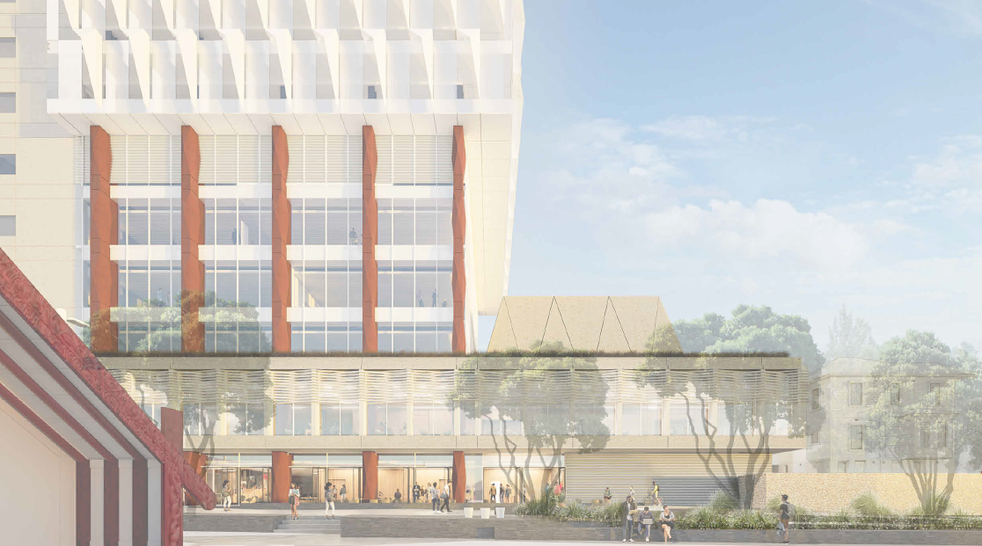
B230 Law and Performing Arts
Concept Design and Development
View from Waipapa Marae

Slide 19
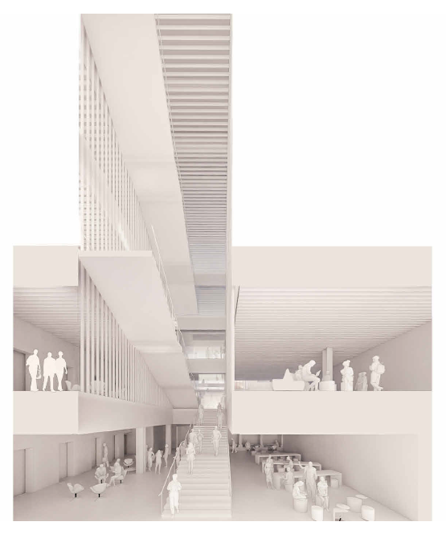
B230 Law and Performing Arts
Concept Design and Development
Interior View Atrium

Slide 20
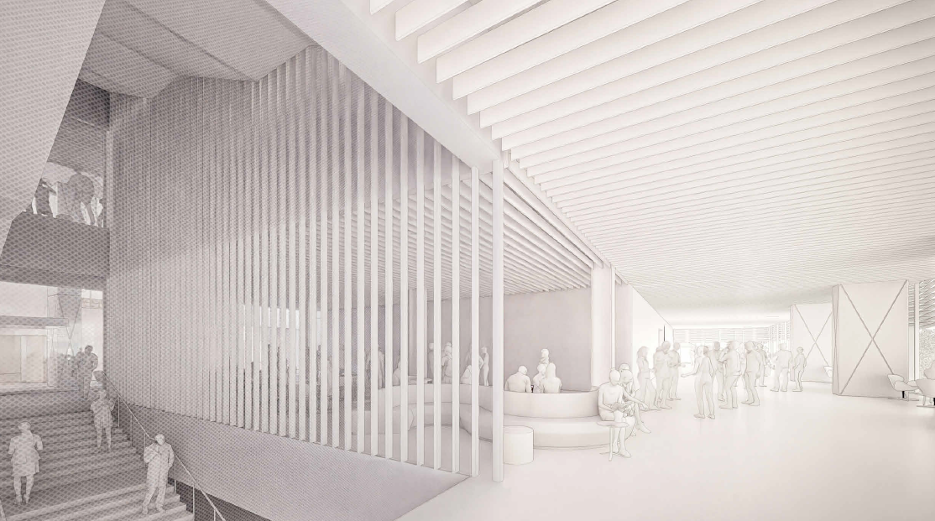
B230 Law and Performing Arts
Concept Design and Development
Interior View Level 1

Slide 21
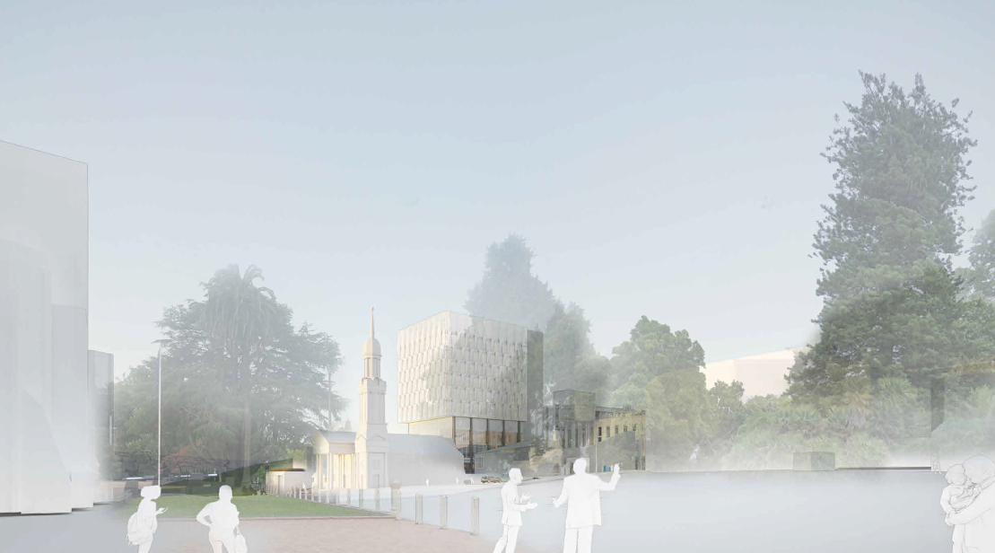
B230 Law and Performing Arts
Concept Design and Development
Townscape View - Auckland High Court

Slide 22
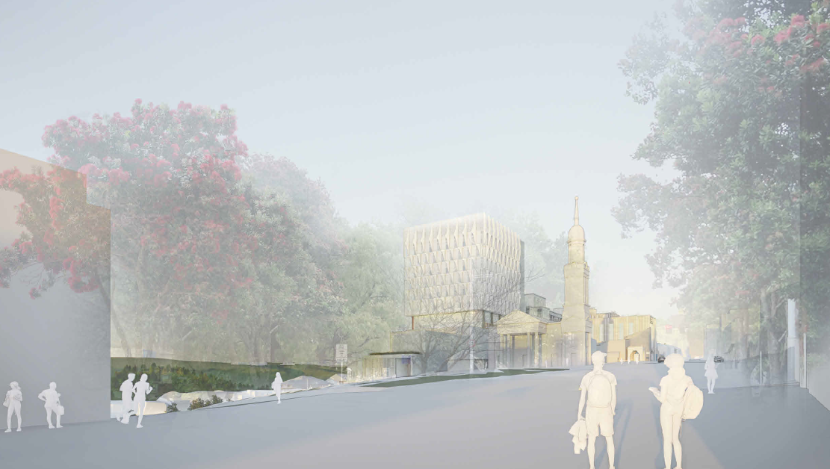
B230 Law and Performing Arts
Concept Design and Development
Townscape View – Anzac Avenue

Slide 23
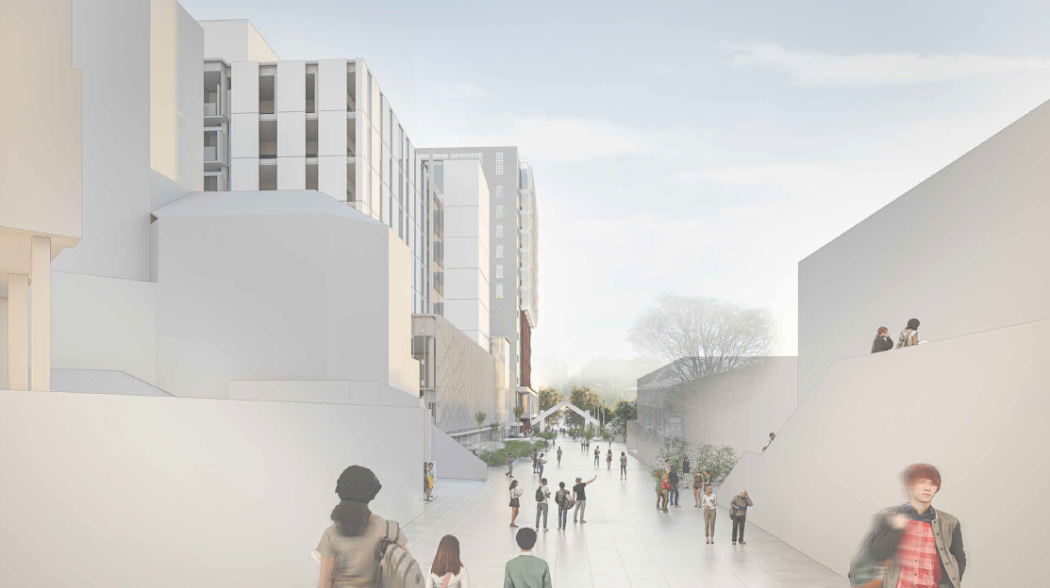
B230 Law and Performing Arts
Concept Design and Development
Townscape View – Wynyard Street

Slide 24
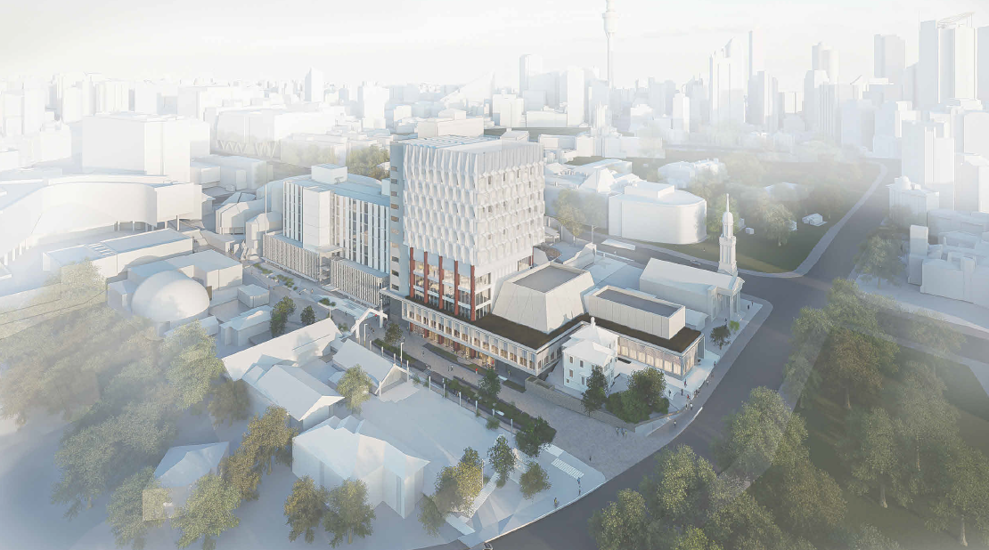
B230 Law and Performing Arts
Concept Design and Development
Townscape View - Aerial
Notes:
1 square edge = 200m
User group members have been identified and reviewed by the Dean, Acting Dean and Service Division Directors for their cohort.

Slide 25


Questions, comments, suggestions…

